Slide 1

Final Group Project Presentation
Hire Heroes USA – Client Management
Surbhi Jain
Soumya Shalini
Brahmani Bharatam
Soundarya Raghavan

Slide 2
Overview
About Hire Heroes
Tasks
Data Description
Data Exploration
Data Challenges
Summary Statistics
Data Cleaning
Tasks Exploration
Results, Recommendations

Slide 3
About Hire Heroes
National Non Profit Organization
Headquartered in Alpharetta, GA
Creates job opportunities for US Military Veterans and their spouses.
Provides Online as well as in personal workshop trainings to the veterans.
These services are provided at no cost to veterans.

Slide 4
Recruitment Process Flow
Assessment
Training
Mentorship
Veteran Hired ☺
Registration

Slide 5
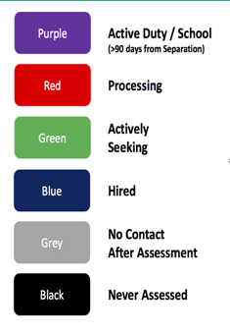
Color Codes

Slide 6
Overview
About Hire Heroes
Tasks
Data Description
Data Exploration
Data Challenges
Summary Statistics
Data Cleaning
Tasks Exploration
Results, Recommendations

Slide 7
Tasks to study
Study relationship between amount of time spent working with individual and how quickly are they employed
Measures should we utilize to process efficiency and program performance
Does working with volunteer raise the probability of client getting
Hired ?
Study relationship between client and employer demographic data and how they contribute to the veteran hire.

Slide 8
Overview
About Hire Heroes
Tasks
Data Description
Data Exploration
Data Challenges
Summary Statistics
Data Cleaning
Tasks Exploration
Results, Recommendations

Slide 9
Dataset
Accounts
Consists of Employer Details
Contacts
Consists of veterans information
Case
Consists of Volunteer Information
Task
Consists of task conducted by HHUSA staff
User
Consist of HHUSA staff information and their roles

Slide 10
Dataset Description
Contacts table has most of the data.
Veterans demographic information.
Details from veteran registration, assessment, training, mentorship, hiring details.
66k records and 675 attributes.
Target Variable : Confirmed Hired Date : which is how many clients are able to successfully obtain employment after using HHUSA services.

Slide 11
Overview
About Hire Heroes
Tasks
Data Description
Data Exploration
Data Challenges
Summary Statistics
Data Cleaning
Tasks Exploration
Results, Recommendations

Slide 12
Data Exploration
Data Challenges

Slide 13
Dataset Issues
There were few thousand records which were usable out of 65K records.
Most of the data was available in a single file – Contacts and other files had limited information pertaining to the tasks.
Most of the columns had more than 70% missing data.
Similar information was repeated in more than one column and distinguishing useful fields was a challenge.
For modeling, most of the fields had to be recalculated to accommodate specific techniques.

Slide 14
Data Exploration
Summary Statistics

Slide 15
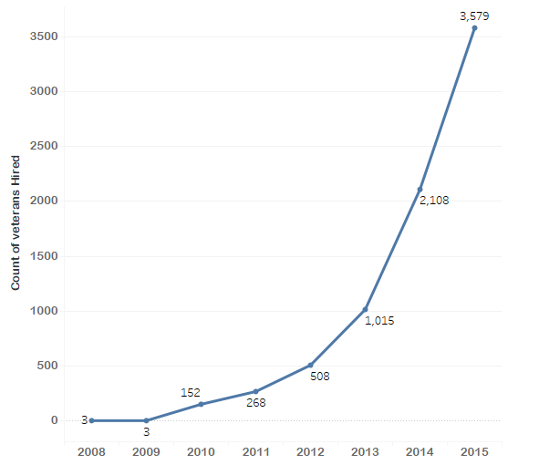
Veterans Hired vs Year
Increasing Trend
Almost 7776 veterans got placed till 2015.

Slide 16
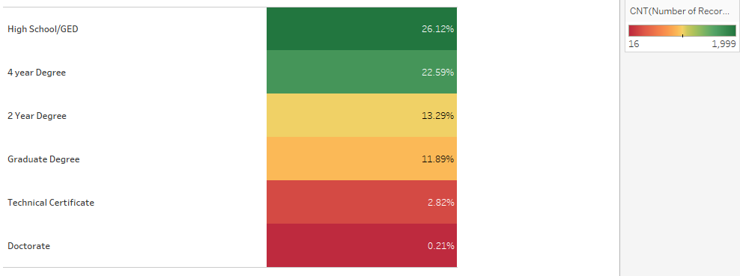
Contribution of Education Level

Slide 17
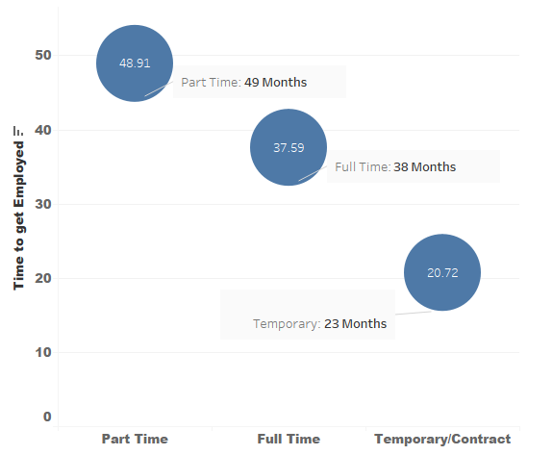
Time to get Employed after Registration
Part Time: 49 Months
Full Time: 38 Months
Temporary: 21 Months

Slide 18
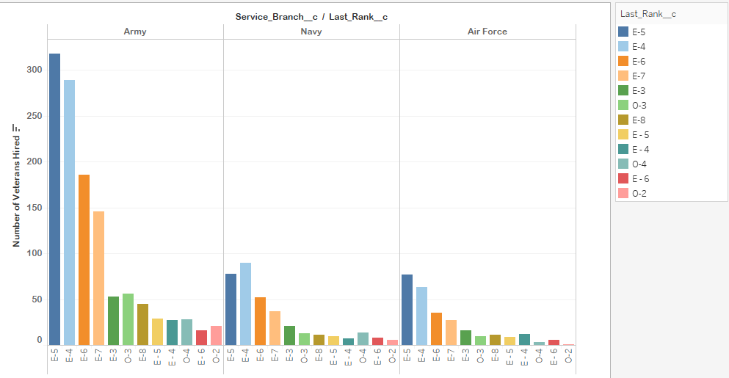
Service/Rank of Hired Veterans
Army veterans have higher hired rate.
Ranks E5, E4, E6, E7 have higher hired rates.
Ranks greater than E4 are classified as senior ranks and hence are considered to be more responsible.

Slide 19
Data Wrangling and Feature Engineering
Removed covariates with almost zero variance.
Reduced dimensionality from 653 covariates to 96.
Total of around 66000 observations.
Removed highly-correlated features.
Transformation and Discretization
Salary, Education, Military Rank
Computed columns for date fields
“Areas of Expertise”, “Desired Job Description”
How to classify text data?

Slide 20
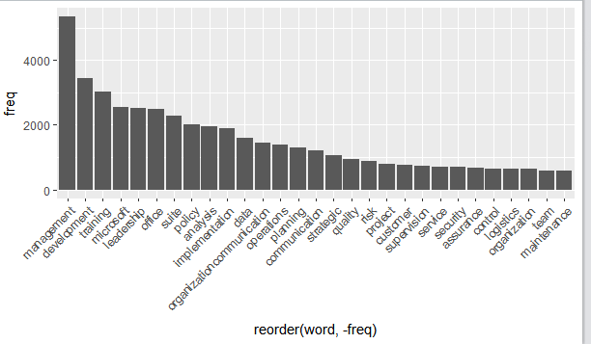

Area of Expertise

Slide 21
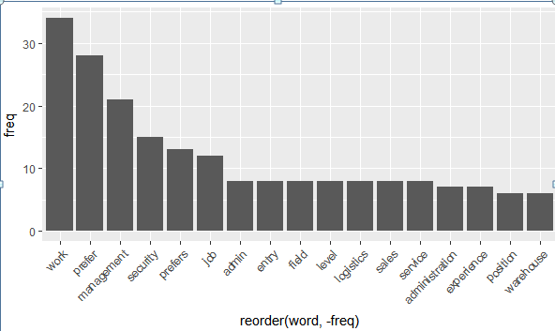

Desired Work Preference

Slide 22
Overview
About Hire Heroes
Tasks
Data Description
Data Exploration
Data Challenges
Summary Statistics
Data Cleaning
Tasks Exploration
Results, Recommendations

Slide 23
Data Cleaning Attributes
Most of the columns in Contacts file had more than 70% missing data and these had to be imputed for further analysis.
For eg. Factors like ethnicity, years of education, experience etc. had about 95% missing data.
There were duplicate ID’s in contacts file which was indicating ambiguous case data.
There were many repetitive columns for the same information.

Slide 24
Overview
About Hire Heroes
Tasks
Data Description
Data Exploration
Data Challenges
Summary Statistics
Data Cleaning
Task 1 Model Specification
Results, Recommendations

Slide 25
Time Spent by HHUSA Vs Employment
The process for any new veteran being a part of HHUSA for job search includes:
Getting in touch with the team of specialists
Undergoing an assessment to evaluate their existing skills and capabilities
Preparing and finalizing a resume for job search
Attending workshops and career fairs which will lead them to a job.
The first task aims to understand the relationship between time spent by HHUSA with veterans in assisting them for employment and how quickly a veteran gets employed.

Slide 26
Parameters to calculate time spent with veteran
Status__c
Active_Color__c Dat_Initial_Assessment_was_Completed__c
Is_the_Initial_Intake_Assessment_done__c
Date_of_first_contact__c
FirstContact_Assess
Services_provided_Non_HHUSA_Hire__c
Compass_Participant__c
HHUSA_Workshop_Participant__c
Additional_Mentorship_Provided__c
Career_Opportunity_Day_Participant__c
Need_Original_Resume__c
Input_needed_on_Original_Resume__c
Original_Resume_on_File__c
Finalized_HHUSA_revised_resume_on_file_c
Revised_Resume_Used_to_Apply_for_Job_c
Date_Resume_Completed__c
Resume_done_but_needs_additional_work
InitialAssess_Resume
Job_offer_received__c
Confirmed_Hired_Date__c
HiredOrNot
Confirm_InitialAssess
Resume_InitialAssess
Date_turned_green__c Date_Turned_Blue__c
InitialAssess_Green
Green_Blue
InitialAssess_Blue
Date_Submitted_for_Hire__c
ForHire_ConfirmedHire
ForHire_Blue Green_ForHire
Added_to_Partner_Portal__c
Date_assigned_to_partner_portal__c

Slide 27
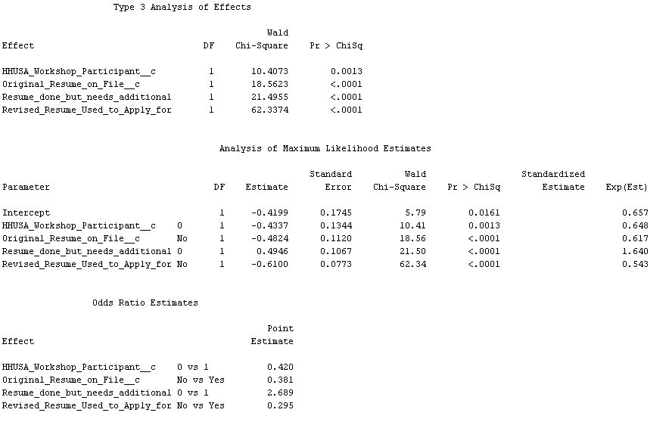
Time Spent by HHUSA Vs Employment
From the regression output, it is identified that workshop participation, original resume on file, revised resume used to apply for job or not seem to be some of the significant factors determining whether a person gets hired or not.

Slide 28
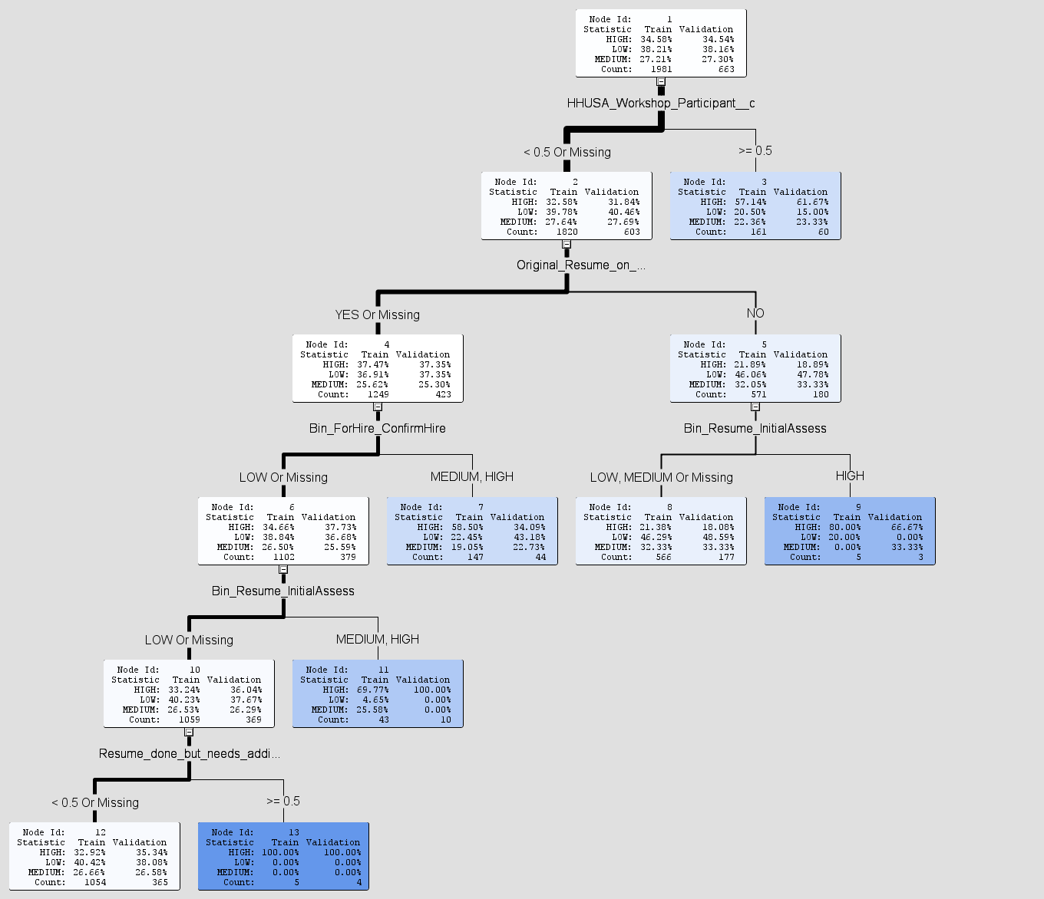
Time Spent by HHUSA Vs Employment
HHUSA Workshop participant, Original Resume on file, Low time taken between date submitted to hire and actual hire date, Low time taken between initial assessment and resume completion, pending work on resume completion are some of the factors determining the time taken to get employed.

Slide 29
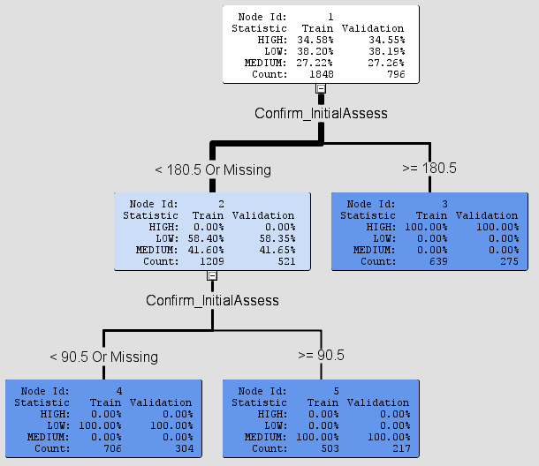
How Quickly Employed ?
This decision tree was used to find out how quickly a veteran gets employed from the time he took initial assessment.
About 38% of them get employed in less than 3 months, 27% of them get employed in about 3 months to 6 months and about 35% of them get employed in greater than 6 months.

Slide 30
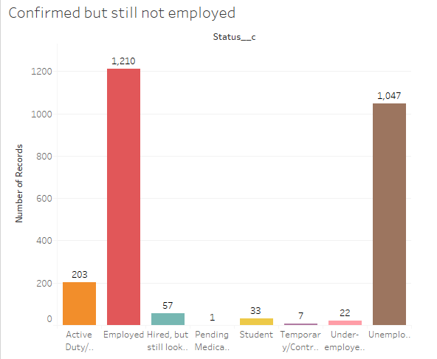
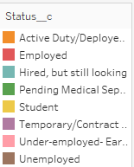
Data discrepancy on confirmed hires
Bar plot depicting the number of confirmed hires and their current status. The status field still has about 1047 people as unemployed which is a discrepancy.

Slide 31
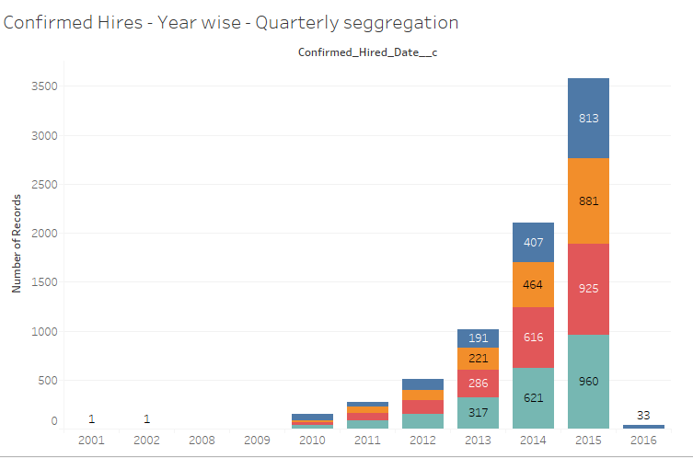
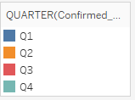
Stats on Confirmed Hires

Slide 32
Overview
About Hire Heroes
Tasks
Data Description
Data Exploration
Data Challenges
Summary Statistics
Data Cleaning
Task 2 Analysis
Results, Recommendations

Slide 33
Measures to increase efficiency

Slide 34
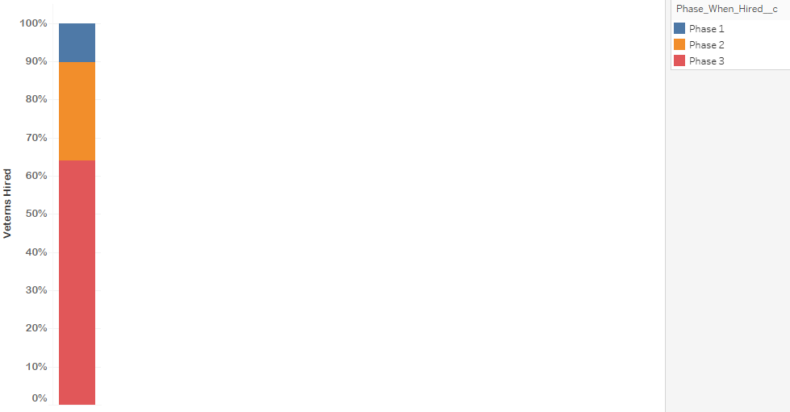
Measures to increase efficiency
Phase 1 : Assessment
Phase2:
Training
Phase3 :
Mentor assigned

Slide 35
Measures to increase efficiency
Average Time taken to complete resume once assessment is done
13 Days
Average amount spent per veteran
Dollars Donated/Confirmed Hires
$249
Resume presented to Employee Partners
8703

Slide 36
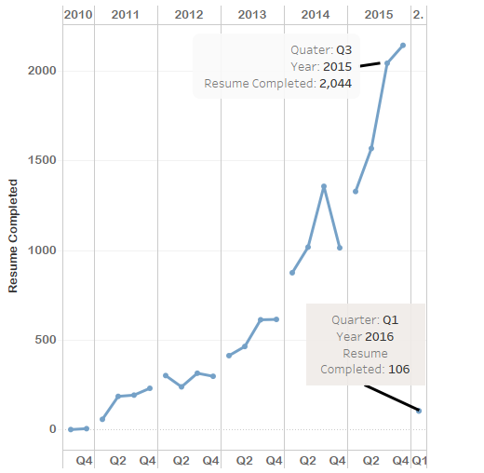
Measures to increase efficiency
Resumes Completed Per Quarter

Slide 37
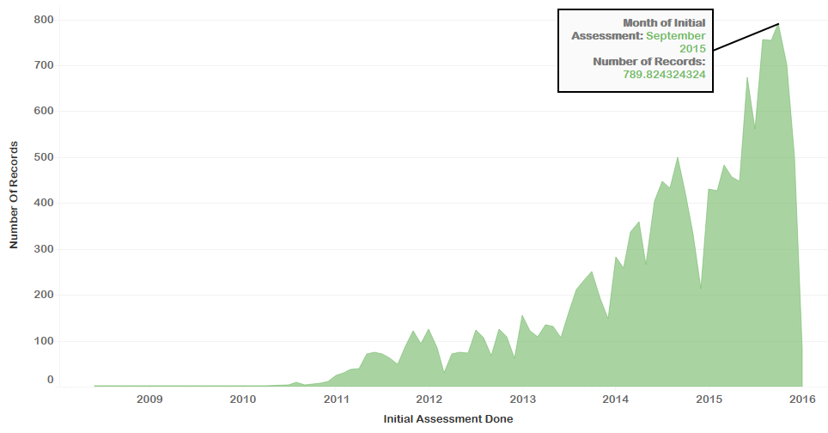
Measures to increase efficiency
Initial Assessment Done per month

Slide 38
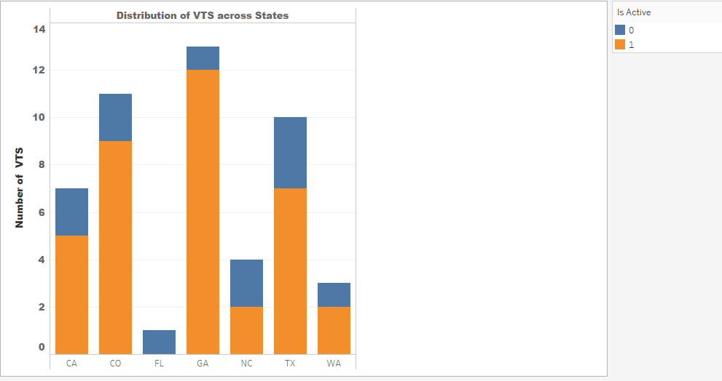
VTS Distribution
VTS : Veteran Transition Specialist
Georgia and Colorado have the highest number of VTS.
Florida is the only state with no VTS.

Slide 39
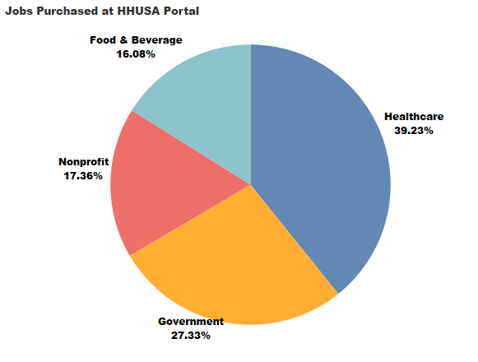
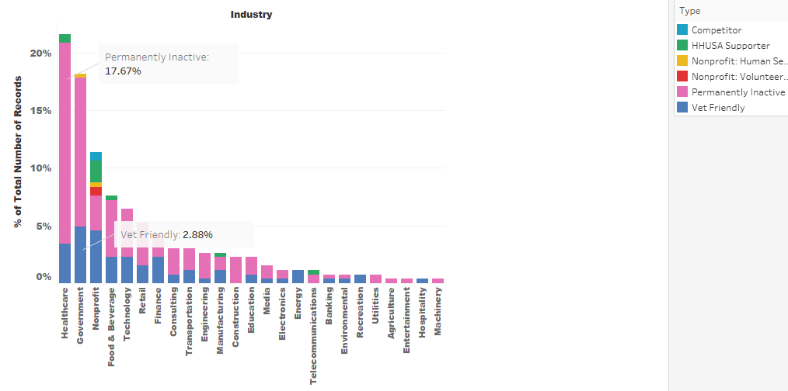
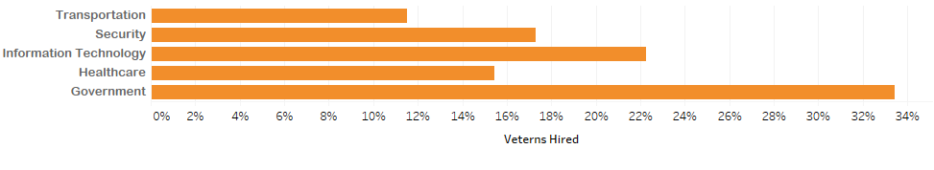
Employers Detail

Slide 40
Suggested Measures to improve Efficiency
Improved Efficiency
Target employment sectors other than government
Raise their funding through some special events or their job boards
Apply some more measures so that they can target veterans to attend workshops
Employer follow – up in case of rejections.
Time for resume building can be reduced

Slide 41
Overview
About Hire Heroes
Tasks
Data Description
Data Exploration
Data Challenges
Summary Statistics
Data Cleaning
Task 3 Model Specification
Results, Recommendations

Slide 42
Demographic Factors
The following demographic factors have been considered.
Gender
Service_Branch
Highest_Level_of_EducationCompleted__
DD214
Purple_Heart_Recipient
Specialty_Certifications
Is_Disabled
Disability_Rating
priority_veteran
Compass_Participant
HHUSA_Workshop_Participant
Willing_to_relo_with_no_assistance
Service_Rank
Responsive
Interview_Skills
Documents_Received
Bilingual
Specific_Industries_Jobs
Confirmed_Hired_Date
Position_Hired_For
Phase_When_Hired
Job_Type
Industry_hired_in
Salary_Range
Security_Clearance
Foreign_Service
Attended_Day_1
Desired_State_s_of_Employment
Proof_of_Service_Type
Date_of_Service_EntryNew
Date_of_SeparationNew
Hire_Heroes_USA_Confirmed_Hire
Hired_ZIP_Code
Desired_Industry_for_Employment
Willing_to_Relocate
Desired_Earnings_Type

Slide 43
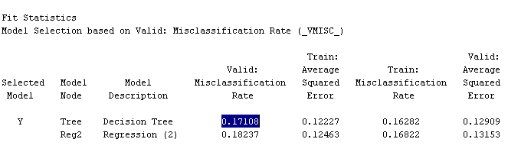
To Identify most influential demographics for Hiring
We have performed Statistical modelling to understand the most influential demographics on Veteran Hiring.
Decision Tree and Logistic Regression models were performed. However we inferred that Decision Tree was more successful in identifying these parameters.

Slide 44
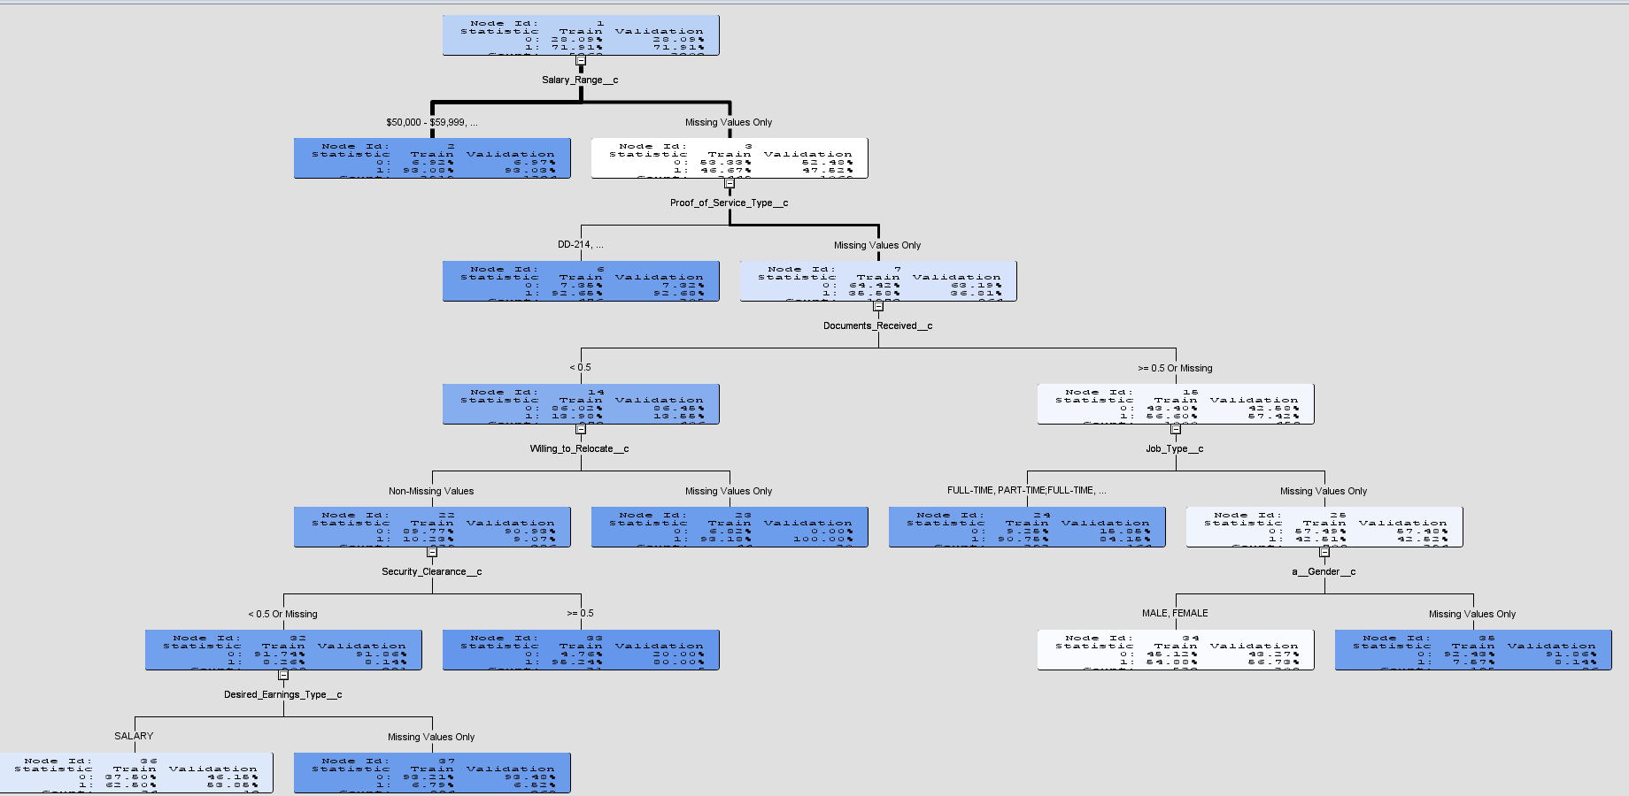
Understanding

Slide 45
Current Influential Demographic Factors for Hiring
From the Model, we see that factors such as:
Gender
Service Branch
Salary Range
Documentation Received
Willingness to Relocate
Proof of service type
Security Clearance
Desired Earning type

Slide 46
Understanding
For veterans with expected salary range between 50,000$ - 59,000$ have been hired. For other cases the proof of service type is checked. If, the document DD-214 is verified there was a sacksful hiring seen. Else other further documents were checked.
For those veterans who did not possess enough documents their willingness to relocate was given a next priority, and the ones willing to relocate saw successful hiring.
However the ones who did not respond positive to this will have to further undergo security clearance and the ones with >=0.5 cleared with hiring,and the other veteran's desired salary type is considered.
If Salary type is regular monthly salary there were hired else not. For veterans whose documents were verified , next decisive factors were their desired job type and gender.

Slide 47
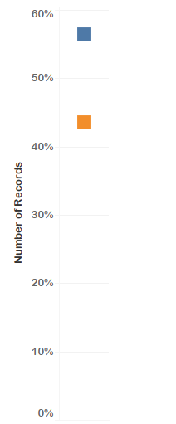

Desired Location Match
Desired Location given by Employer : 43%
Desired Location Not given by Employer : 57%

Slide 48
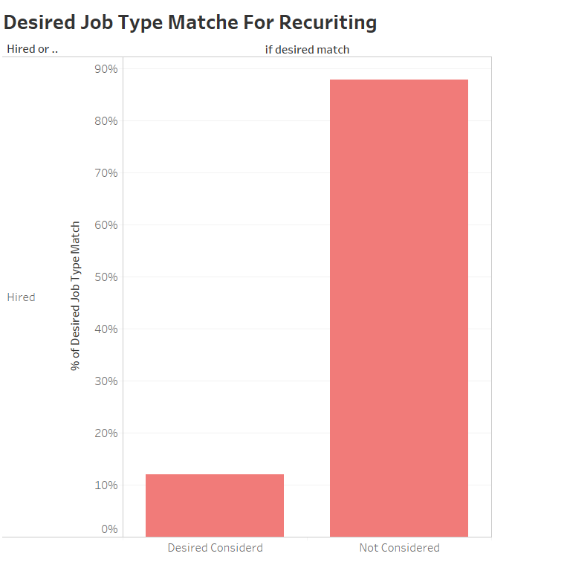
Desired Job Type Considered
F
As per the current scenario only 12% of the cases were seen with veteran job type preference consideration. 87% of the times they dint.
This could be one of the major reasons for veterans not faring well. The HH Team shall have to check for ties with current employer trying to consider Veteran preferences.

Slide 49
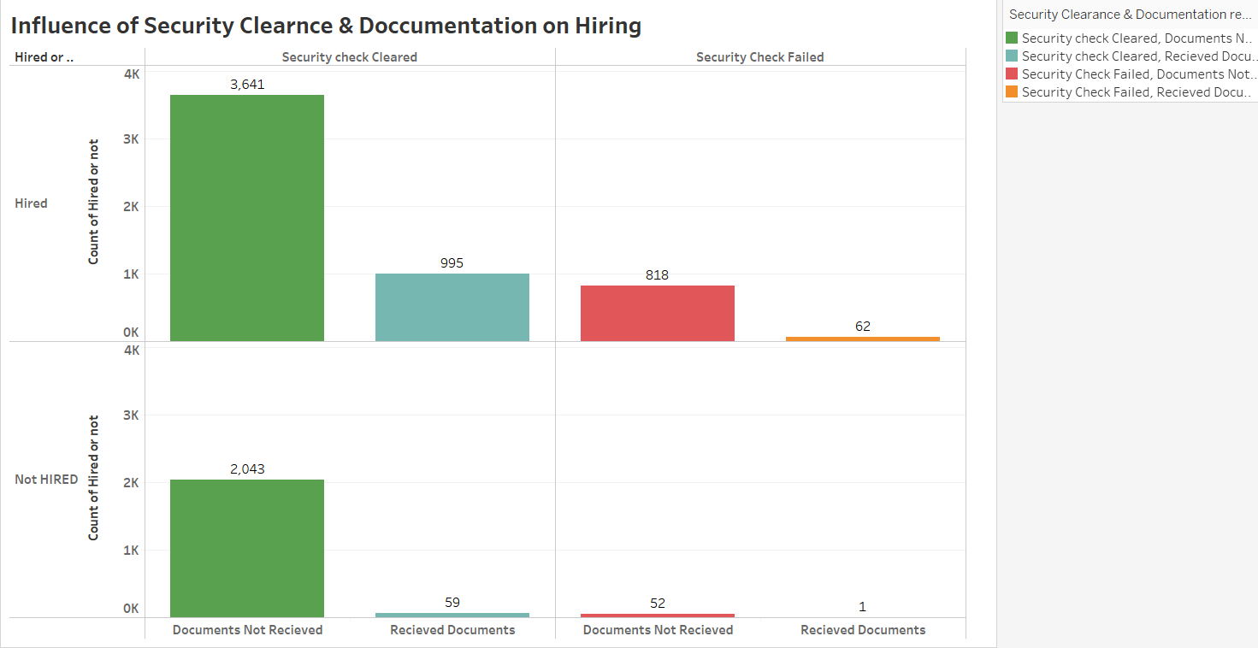
Security Clearance & Documentations
Security clearance is indeed given a weighted priority. Maximum hiring was seen for veterans who cleared Security Clearance
Also, we see that people who cleared security check but with no proper document submission were not hired. HH Team can work and ponder more in this regard and ensure these people

Slide 50
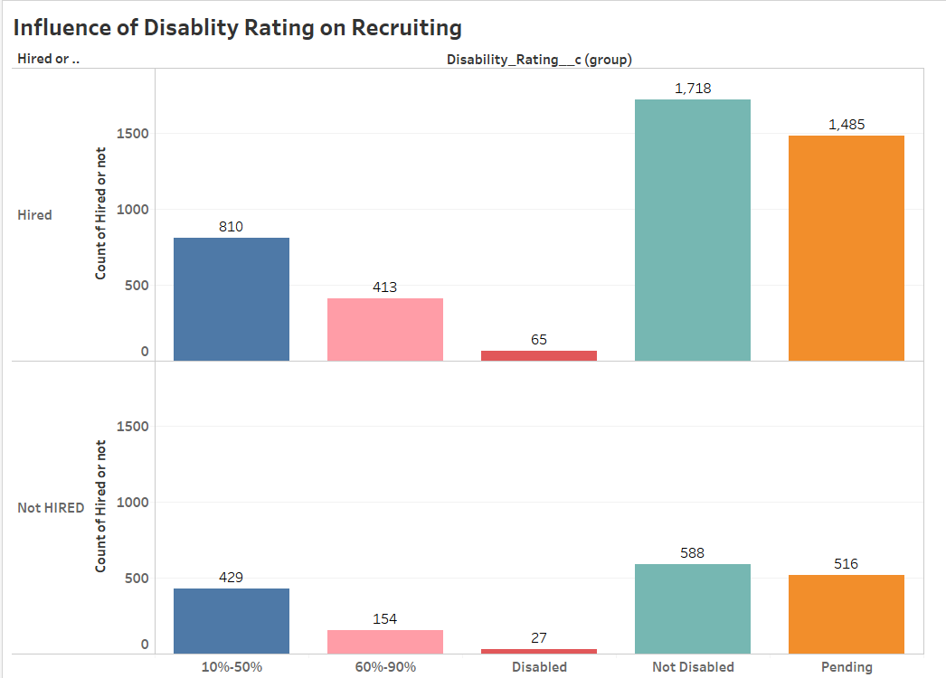
Disability Rating
Much of the hiring was preferred for Veterans with no disability of pending status, and with disability are minimal hired which looks logically acceptable.
Also, low/minimal disability veterans see a similar trend in Hired and Not hired cases. The HH team can take further more initiatives to increase hiring for minimal disability veterans in the most suitable way.

Slide 51
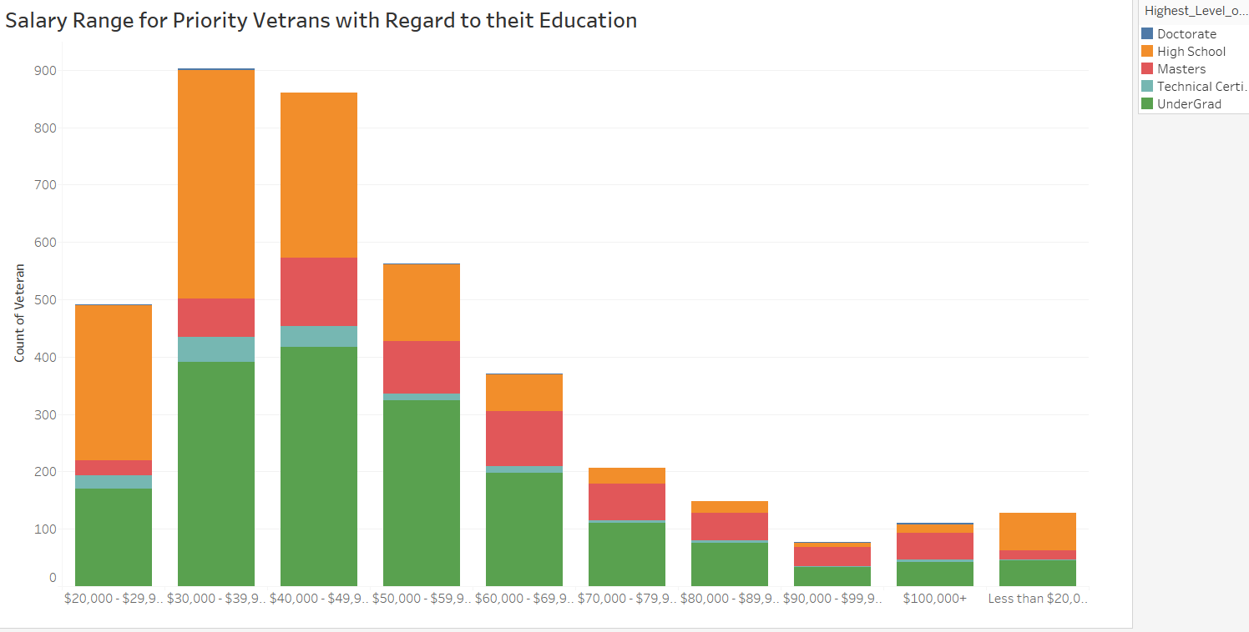
Salary Range Distribution by Education
Veterans with highest Education up to either undergrad or high school have jobs in the maximum range of salary
Major Earning Range 30,000$ to 50,000$

Slide 52
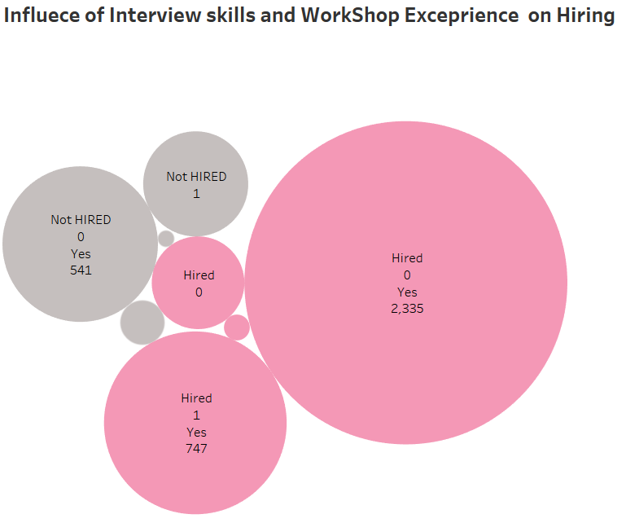

Interview/Workshop Skills for Hiring
We see that Interview skills are given an utmost priority , If a veteran possessed interview skills then having skills from workshops etc., did not matter. However major hiring was seen when veterans have significant amount of Interview skills.

Slide 53
Overview
About Hire Heroes
Tasks
Data Description
Data Exploration
Data Challenges
Summary Statistics
Data Cleaning
Task 4 Quantitative Analysis
Results, Recommendations

Slide 54
Assumptions
The request for volunteer activity occurred before the reported hire date
A comparison between contact records for clients that did go through a volunteer activity and those that did not
Enrollment for Volunteer help with only “Completed” status considered
Multiple HHUSA hire not considered as the services offered could be anything other than Volunteer Services

Slide 55
Filters and Data Transformations
Difference between “Date Turned Blue” and “Date Turned Green” considered as “Time taken to get hired”
Difference between “Closed Date” and “Created Date” considered as “ Time amount of Volunteer help undertaken”
Clients with “Confirmed Hire Flag”(calculated) as 1 or Active Color Blue are considered ‘Hired’
The column “Salary Range” was converted from categorical range to numerical mean.

Slide 56
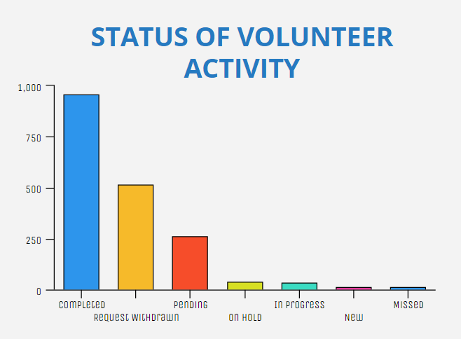
Comparison Between Status
Huge Number of Clients have withdrawn from taking volunteer help
Many Clients are in Pending Status waiting for Confirmation

Slide 57
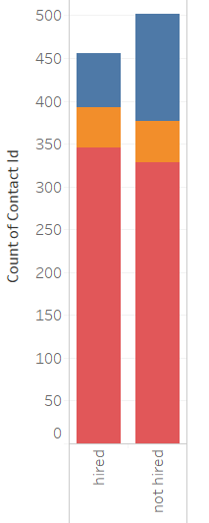

Hire Status for Various Volunteer Activities
Reason | Hired (%)
Mock Interview | 75.66
Federal Resume Review | 10.31
Career Counseling | 14.04
Reason | Not Hired (%)
Mock Interview | 65.34
Federal Resume Review | 9.56
Career Counseling | 25.10

Slide 58
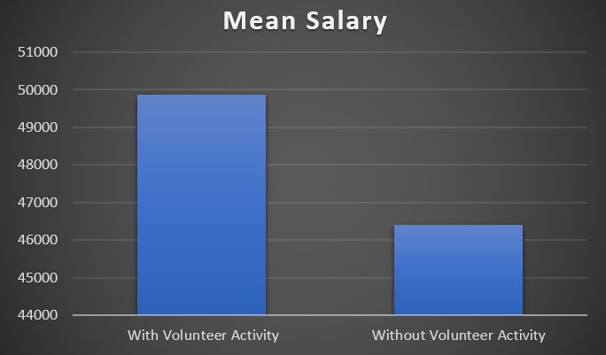
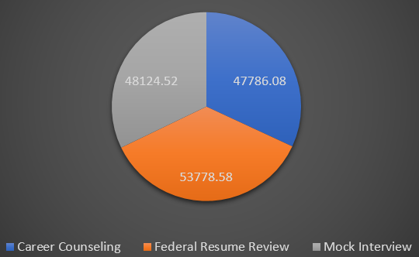
Effects of Volunteer Activities on Job Quality
Mean Salary of clients taking volunteer help is more
Average Salary of clients taking help on Federal Resume Review is highest

Slide 59
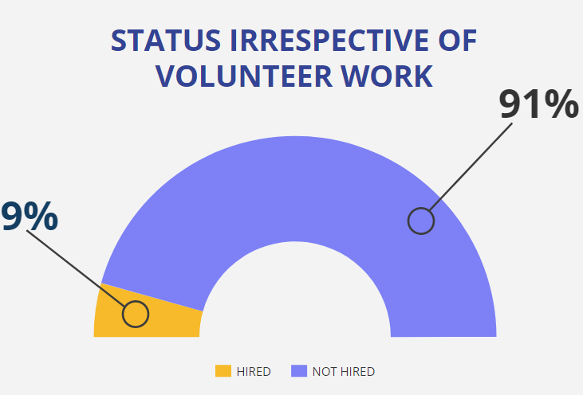
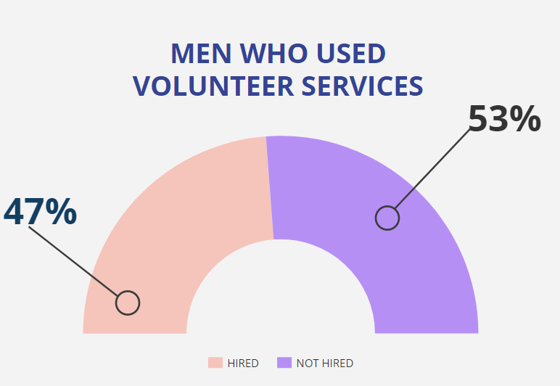
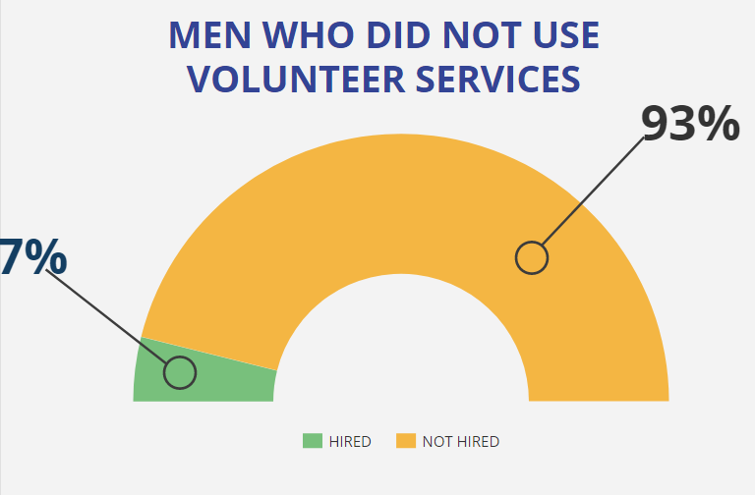
Comparison: Hired– Not Hired

Slide 60
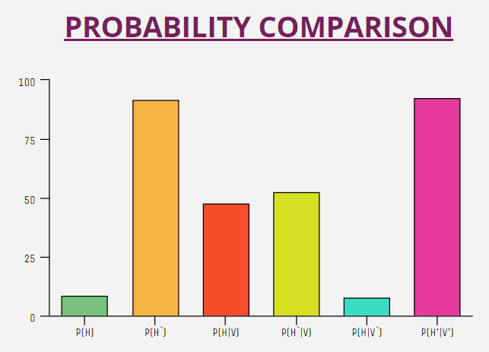
Does working with Volunteers lead to getting Hired?
Observing how probability of a client getting hired is affected by observing number of clients undertaking volunteer help
Condition | Volunteer Association | No Association
Hired | 456 | 4891 | 5347
Not Hired | 502 | 58043 | 58545
 | 958 | 62934 | 63892

Slide 61
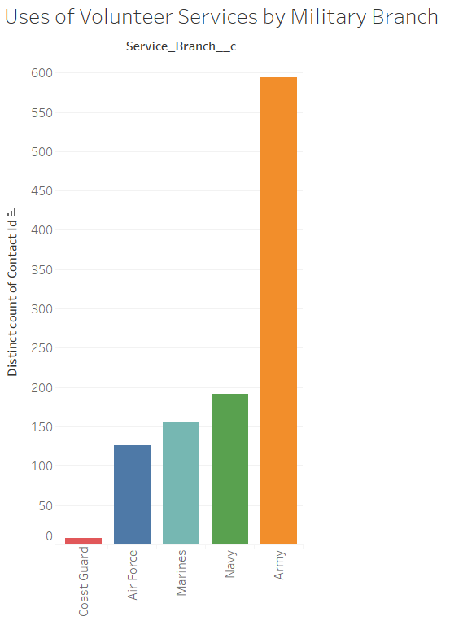
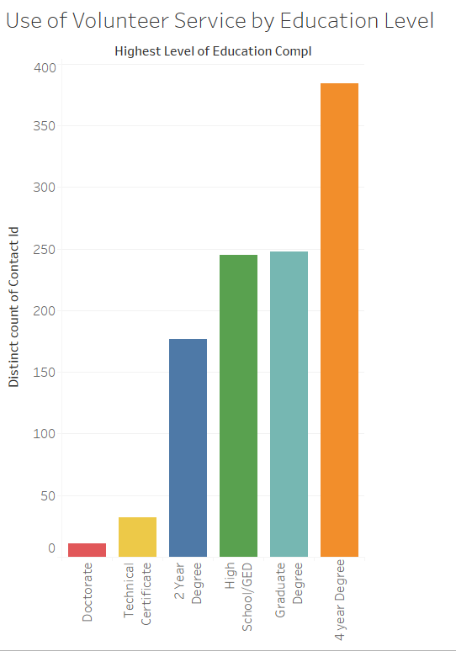
Mean Use of Volunteer Services
By Military Branch
By Education Level

Slide 62
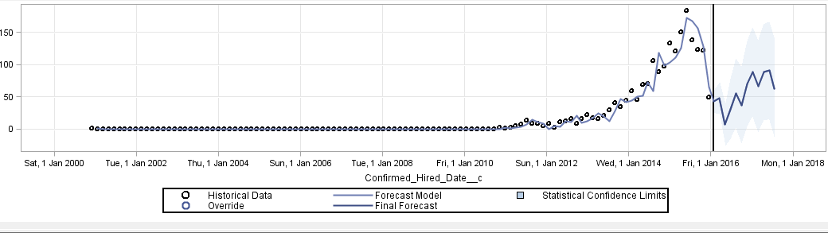
Forecasting
DD214 and workshop participant Impact .
Graph shows hiring trend .
Absence of DD214 impacts the hiring trend.

Slide 63
Overview
About Hire Heroes
Tasks
Data Description
Data Exploration
Data Challenges
Summary Statistics
Data Cleaning
Model Specification
Results, Recommendations

Slide 64
Recommendations
Inconsistencies in state codes
Missing Data in important factors
Proper update of Dates should happen
Proper check on Employer records and status
Admission process must be fast tracked
Allocate resources for volunteer program
Encourage HHUSA workshop participation
Resume building is critical

Slide 65
Recommendations
Years of Education and Years of Experience data has lot missing. Since these are important factors in hiring process, it is recommended to be taken care of.
Inconsistencies with state codes.
Some records had initial assessment date lesser than resume date. Probably those veterans had an appropriate resume already and didn’t work on it with HHUSA. However, since this was a major discrepancy, we suggest they have a proper mechanism to handle it.
They don’t update records uniformly. for ex : there are many records for which init assessment date but init assessment completed flag was populated.
Most of the major hiring employment records are permanently inactive which needs to be investigated.
Confirmed hire date was populated but Hired flag was 0.

Slide 66
Recommendations contd…
Based on the analysis, the volunteer program has a significant causal effect on hiring outcomes.
Because the volunteer program has been shown to be effective, Hired Heroes should allocate resources in expanding it.
More emphasis must be given to clients willing to take Volunteer help in order to stop application withdrawal.
Enrollment process for volunteer help must be fast-tracked to minimize pending applications.
Overall, Salesforce data has to be streamlined for further explorations.

Slide 67
Tools Used
SAS E Miner
SAS E Guide
Tableau
R
Excel

Slide 68

Questions ??

